Slide 1
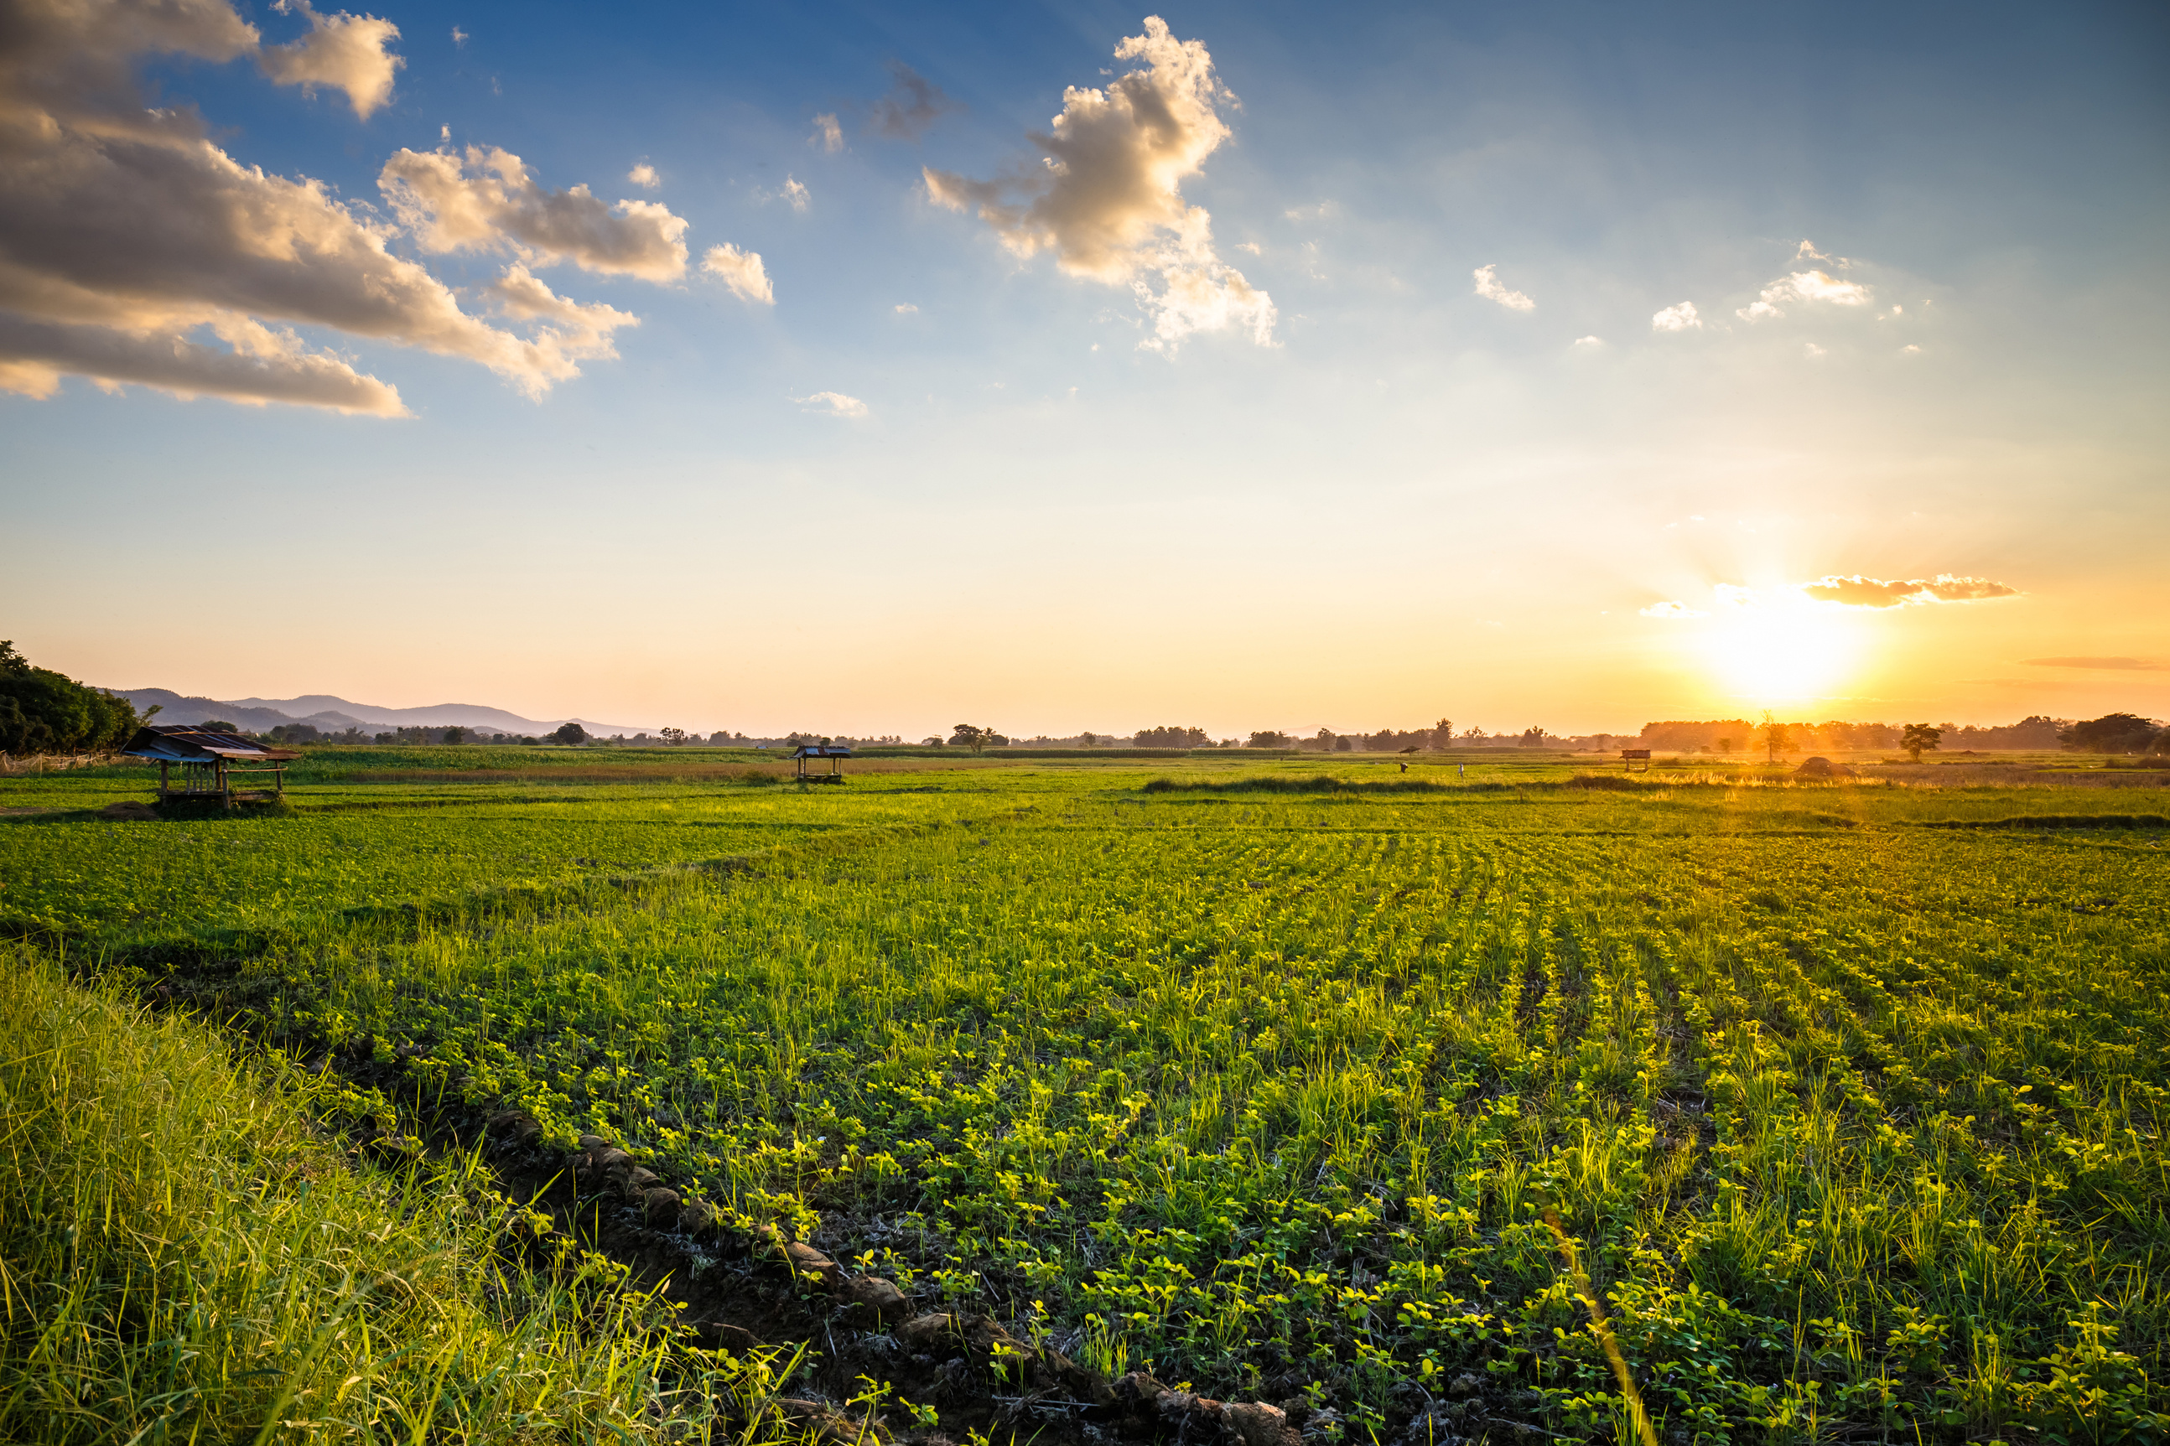


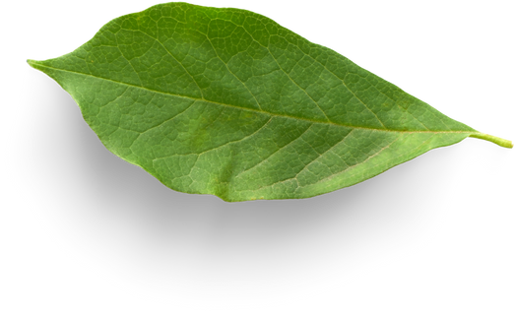





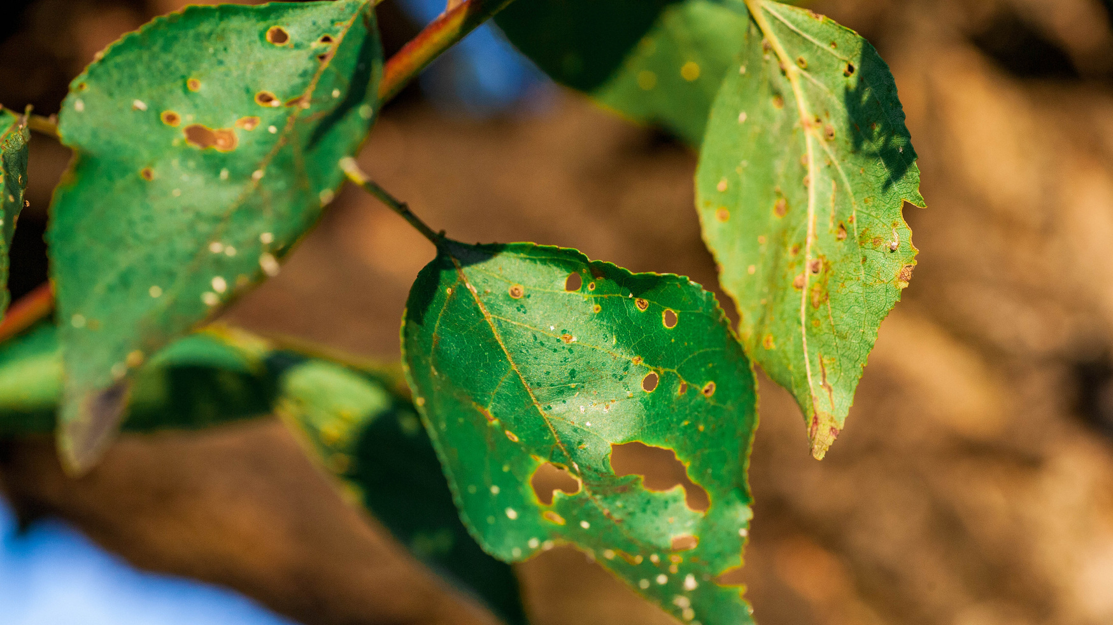


KRISHI SAATHI
Team Name: HackSquad
Problem Statement ID: 1638
Problems Addressed: Direct International Marketplace Access, AI-Driven Crop Disease Prediction and Management & Support System, Pet Health Management System
Problem Statement Category: Software
Where Tradition Meets Technology
Key features
Crop Disease Diagnosis & Management: AI-powered image analysis for early detection and treatment recommendations (both chemical and organic).
Market Intelligence & Direct Access: Real-time market prices, quality assessment, and direct connection to primary markets across India and internationally.
Personalised Crop Recommendations: Suggests suitable crops based on soil, weather conditions, and water availability.
Weather Forecasting & Alerts: Real-time weather updates and crop-specific advisories.
Livestock Health Management: AI-based health estimation and growth management, including live video consultations with experts for advice on crop growth and issues.
Increased Yields & Quality: Enhanced crop health and increased yield per acre through these measures.
krishisathi.aryanvbw.live

Slide 2
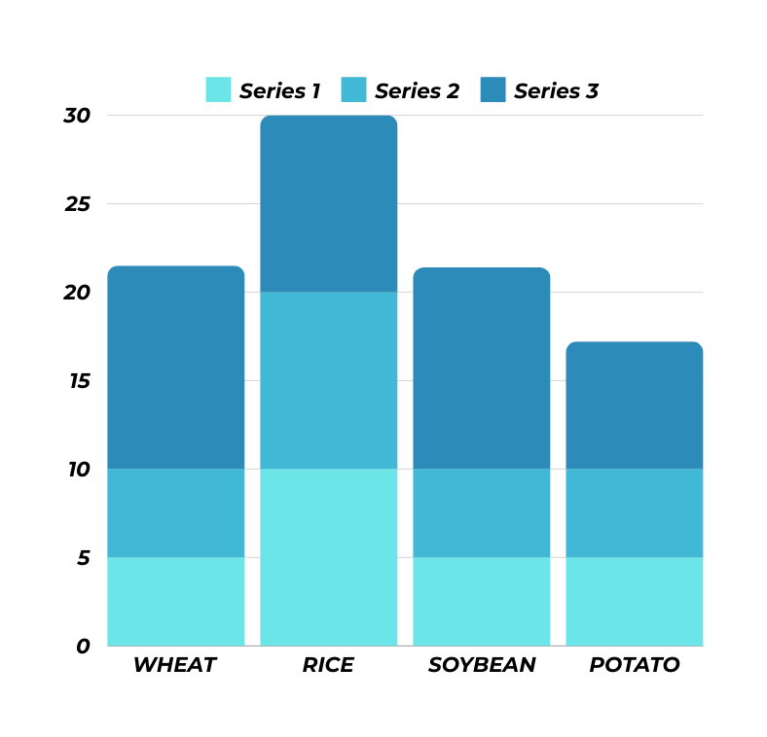



Crop Loss Data
Problems
krishi saathi
Crop suffer with?
Farmers struggle with unhealthy crops and low yields because they don't always know the right amount of fertilizer and pesticide to use, or when the weather might cause problems. Sometimes they use too much, sometimes too little, and sometimes the weather just doesn't cooperate
Nutrient Deficiencies
Soil Health
Weather
How can over fertilizer practices be improved to promote soil health and long-term sustainability?
How weather can create impact on crop helth ?
How can farmers ensure crops receive adequate nutrients without over-fertilizing?
krishisathi.aryanvbw.live

Slide 3

Purpose: Help people and communities through innovative technology.
1. Crop and Farming Assistance: • Diagnose crop problems using photo analysis. • Identify nutrient or water deficiencies. • Provide tailored solutions using ChatGPT APIs and custom models trained for Indian agriculture. • Collaborate with agricultural experts and gather data from 1,000+ farmers per state.
2. Direct Market Access: • Compare market prices across regions for crop selling. • Use AI to assess crop quality and recommend the best market using photo of crop.
3. Crop Recommendations:
• Suggest crops based on local soil types, climate, and water sources.
• Promote organic farming methods and alternatives to chemical pesticides.
4. Animal Care:
• Estimate animal weight and age (via teeth) for proper veterinary care.
• Use AI to provide 95% accuracy in weight estimation across various breeds.
• Goal: Empower farmers and pet owners with simple and brilliantly effective solutions.

Slide 4


TECHNICAL
APPROACH
1. Mobile App Development: The app will be built using React Native or Flutter for both Android and iOS platforms. The UI will be intuitive and User-friendly, incorporating image/video processing capabilities and seamless API integration.
3.Integration and Deployment: The app will be integrated with ChatGPT APIs, weather APIs, and a video call feature. The back-end will be deployed on the cloud, and the app will be published on app stores.
4.Data Collection and Management: Data will be gathered from various sources, including agricultural experts, farmers, and government agencies. The data will be cleaned and preprocessed before being stored and managed efficiently.
2.Backend Development: Backend will leverage cloud platforms like AWS . It will utilize a robust database and AI/ML models for crop disease prediction, price forecasting, and livestock weight estimation. we also use python in back-end.

Slide 5

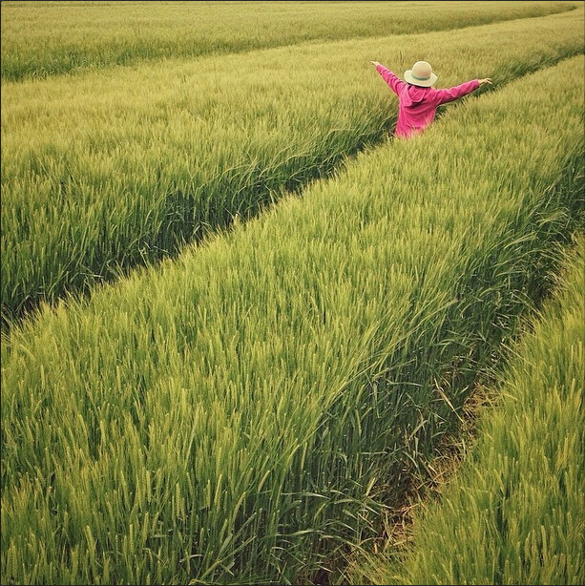

“Stubble” A Major Problem in North India
Stubble (parali) burning is a method of removing paddy crop residues from the field to sow wheat from the last week of September to November.
Solution
Indian Avi.ation will use 20 pc biofuels, made from stubble over the next five years. Our Application will not only cognize but provide wholesale market to ‘Farmers’ to sell the stubble which was earlier Smouldered
Krishi Saathi
krishisathi.aryanvbw.live

Slide 6









Communicate with APIs, such as the weather API, to provide accurate solutions
Krishi saathi’s expert for suppor
Krishi Saathi Cloud Server
The app sends all data, including photos and location, to the server. After processing, the server responds by sending information about the crop disease, providing the location. It fetches data from an API regarding where to send it to the farmer, along with solutions for crop diseases, including organic and chemical fertilizer recommendations.

